Slide 1
Welcome
Be Proactive
Notes:
In every slide, ask the audience before you conclude

Slide 2


Slide 3
Introduction
The 7 Habits of Highly Effective Teenagers
By Sean Covey

Slide 4
Be Proactive
I am the force
The proactive approach to a mistake is to acknowledge it instantly, correct and learn from it."
-DR. STEPHEN R. COVEY

Slide 5
Proactive from English Teacher
Greek prefix ("pro-" meaning "before") with a Latin root, "active".

Slide 6
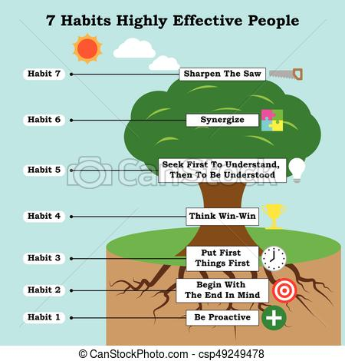

Slide 7
Proactive students do
Be Proactive is about taking responsibility for your life.
You can't keep blaming everything on your parents or grandparents.
Proactive people recognize that they are "response-able."
They don't blame genetics, circumstances, conditions, or conditioning for their behavior.
They know they choose their behavior.

Slide 8
Reactive Students
are often affected by their physical environment.
They find external sources to blame for their behavior.
If the weather is good, they feel good. If it isn't, it affects their attitude and performance, and they blame the weather.

Slide 9
All of these external forces act as stimuli that we respond to.
Between the stimulus and the response is your greatest power--you have the freedom to choose your response.
One of the most important things you choose is what you say.
Your language is a good indicator of how you see yourself

Slide 10
A proactive person uses proactive language--I can, I will, I prefer, etc.
A reactive person uses reactive language--I can't, I have to, if only.
Reactive people believe they are not responsible for what they say and do--they have no choice.

Slide 11
Proactive people focus their efforts on their Circle of Influence.
They work on the things they can do something about: health, children, or problems at work.
Reactive people focus their efforts in the Circle of Concern--things over which they have little or no control:
the national debt, terrorism, or the weather.

Slide 12
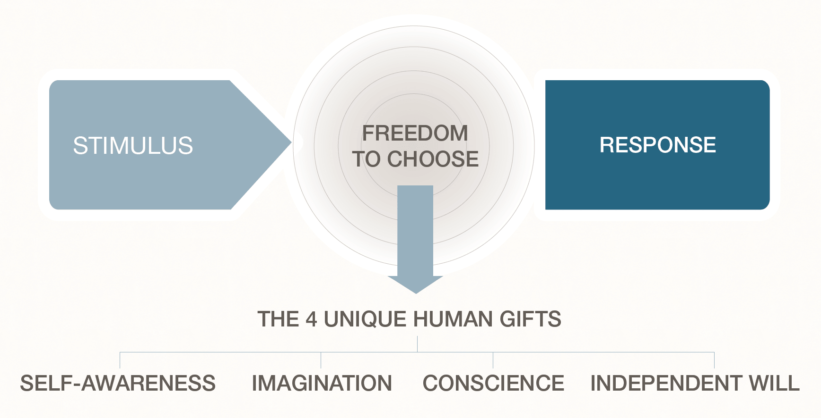

Slide 13
Its your Choice
If you want to become Mad
If you want to become Sad
If you want to get Angry
If you want to be Annoyed
If you want to Shout
If you want to take revenge

Slide 14
It is your choice
To smile
To be happy
To be in peace
To appreciate
To appologise
To feel proud and pride

Slide 15
Who or What(Activity)
Write down your current Problems?(finance/Health/Emotion…)
Write down your past problems?
Who or What are the reasons for these problems?

Slide 16
Activity 2
He made me angry
He is the reason for my failure
He is one who made me to fight
He insulted me
He spoiled my mood
Who tell this proactive or reactive students?
How the other person can tell?

Slide 17
Reactive Student vs Proactive Student
Reactive Students are like Soda bottle, if life shakes them a bit, the pressure builds and they suddenly explode
Proactive students are like water bottle, pressure never builds.

Slide 18
Scene - 1
Your friend is taken your handwritten subject note book with him to his native, You need it urgently…what is your response?

Slide 19
Scene - 2
Your parents suddenly facing a financial problem and finding it difficult to pay your current semester fee, what is your reaction?

Slide 20
Reactive and Proactive
Language is very important
How you talk about it?
How you express?...

Slide 21
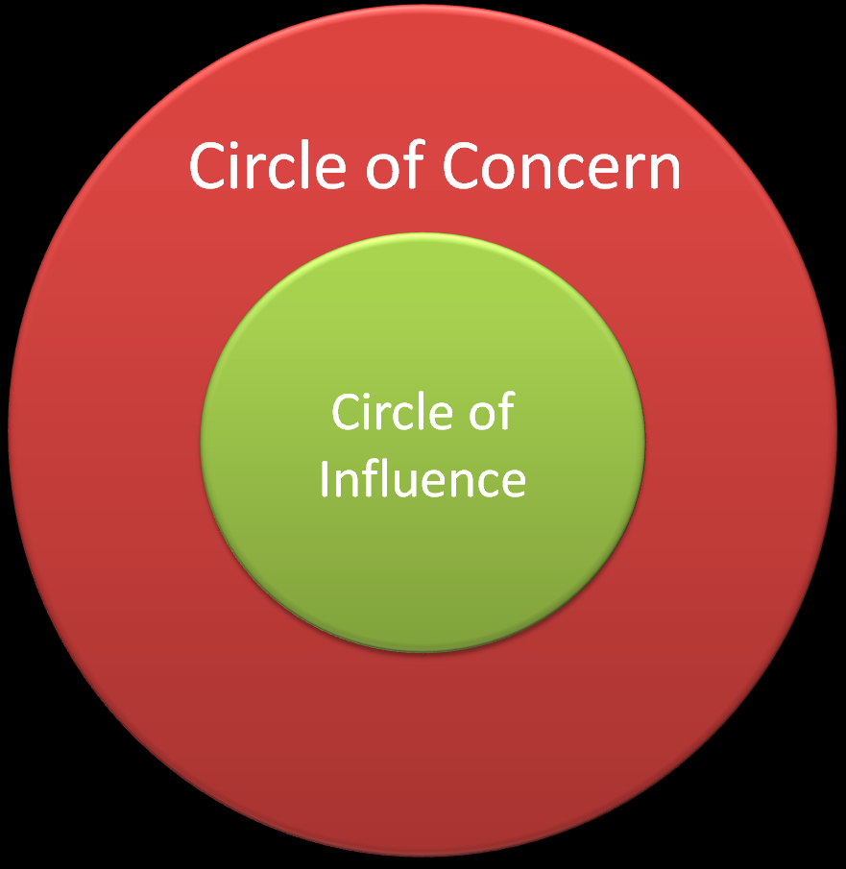

Slide 22
Proactive vs Reactive
Proactive behavior involves acting in advance of a future situation, rather than just reacting.
It means taking control and making things happen
Not just adjusting to a situation or waiting for something to happen

Slide 23
Be Proactive is about taking responsibility for your life.
You can't keep blaming everything on your parents or grandparents. Proactive people recognize that they are "response-able." They don't blame genetics, circumstances, conditions, or conditioning for their behavior.

Slide 24
Example – Going for a Tour
Proactive students – what they will do
Reactive students – What they will do

Slide 25
Who is proactive student..
always seem to have a spare pen to loan,
a safety pin to offer,
a Band-Aid or
pain killer when someone’s in distress and shampoo in the Hostel

Slide 26
Who is a reactive student…
He is the one who is in the receiving end

Slide 27
Going to Interview
Proactive Students – what they do?
Reactive Students – What they do?

Slide 28
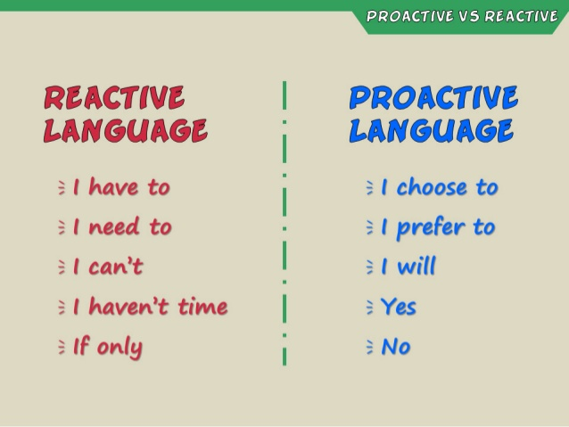

Slide 29
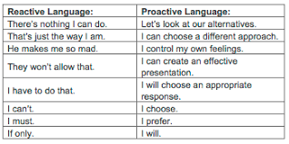

Slide 30
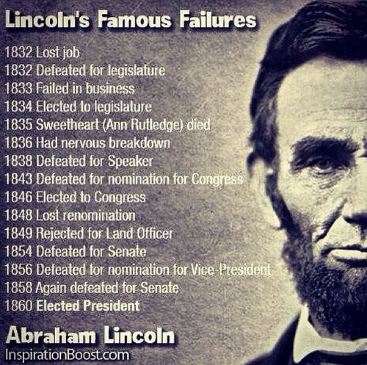
Abraham linkan

Slide 31
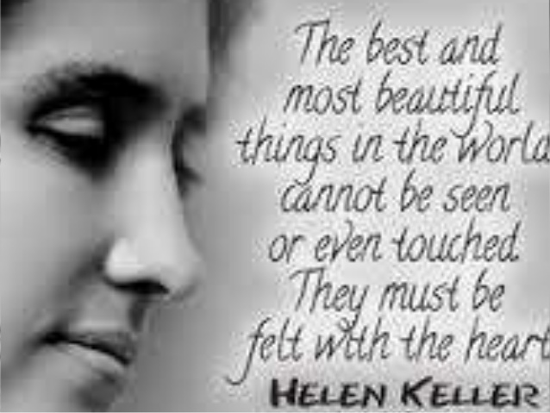

Slide 32
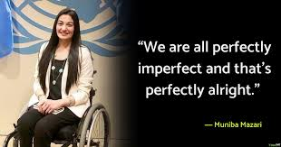

Slide 33
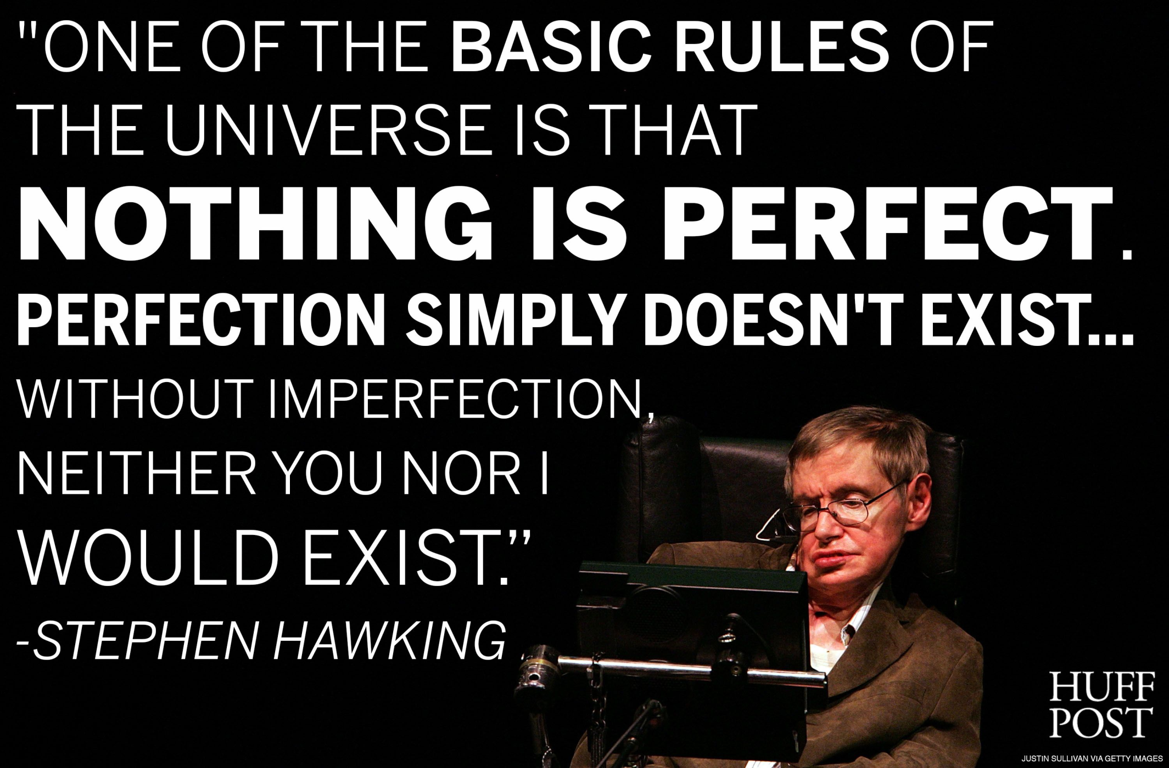

Slide 34
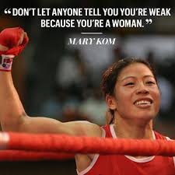
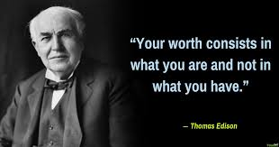

Slide 35
Summary
You should drive your life vehicle
You should be responsible for your life
Be a solution, Not a problem
Accept the situation, before act
Don’t react, respond
Smile

Slide 36
Thank you for your valuable time and support
Any questions..?

